Slide 1
DESCARTES VS. LOCKE
BQ1 Foundations Lesson 8
I can say whether I follow a rational or empirical approach to knowledge
Notes:
See how this lesson links to the course by viewing the final slide
Key TOK terms appear in a red font

Slide 2
Starter
How do you know with certainty that you’re not part of the Matrix, and that the reality you see is just an illusion?

Slide 3
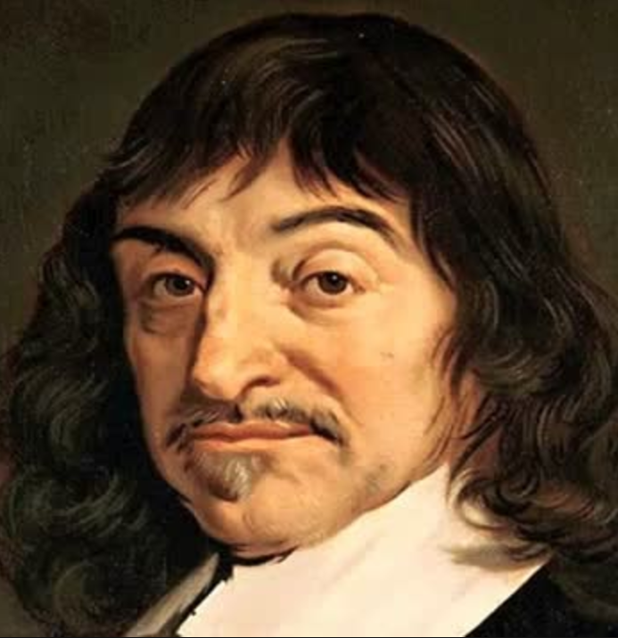
Representing rationalism...
Listen to the podcast on Descartes’s approach to knowledge
Write, pair, share: What are the fundamentals of rationalism?
Notes:
The podcast can be found here.

Slide 4
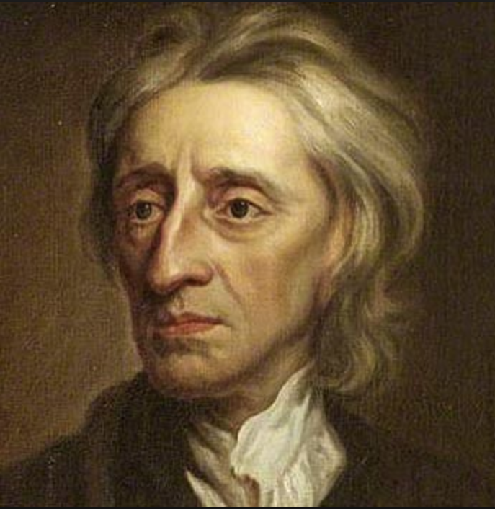
Representing empiricism...
Find out about John Locke – how did his ideas and approaches to knowledge differ from Descartes?
Notes:
Use this theoryofknowledge.net discussion point document to help here.

Slide 5
4-slide presentation
Produce a Google Slides presentation, with the following content:
Slide 1 An outline of Descartes’s approach to knowledge
Slide 2 An outline of Locke’s approach to knowledge
Slide 3 An explanation of which approach you prefer, and why
Slide 4 A bibliography slide
You MUST include in your presentation a link to the coherence and correspondence truth tests.
Notes:
Student notes can be found here on the two approaches to knowledge.
The coherence truth test has a lot in common with the rationalist (Cartesian) approach to knowledge. The correspondence truth test matches up to an empirical (Lockean) approach.
Get students to swing one way or the other, and be ready to vigorously defend their position.

Slide 6
Links to the TOK exhibition
Related exhibition prompt Are some types of knowledge more useful than others (IAP-2)?
Refer to the ideas from this lesson to answer this question.
For example, is rational or empirical knowledge more ‘useful’ in helping us to understand the world? How should we define ‘useful’?
Which objects could help to illustrate your answer?
Notes:
Optional slide, if you want to help students to take ownership of the IA prompts (IAPs) for the TOK exhibition
For more ideas on relevant IAPs, see the ‘Linking this lesson to the course’ slide

Slide 7
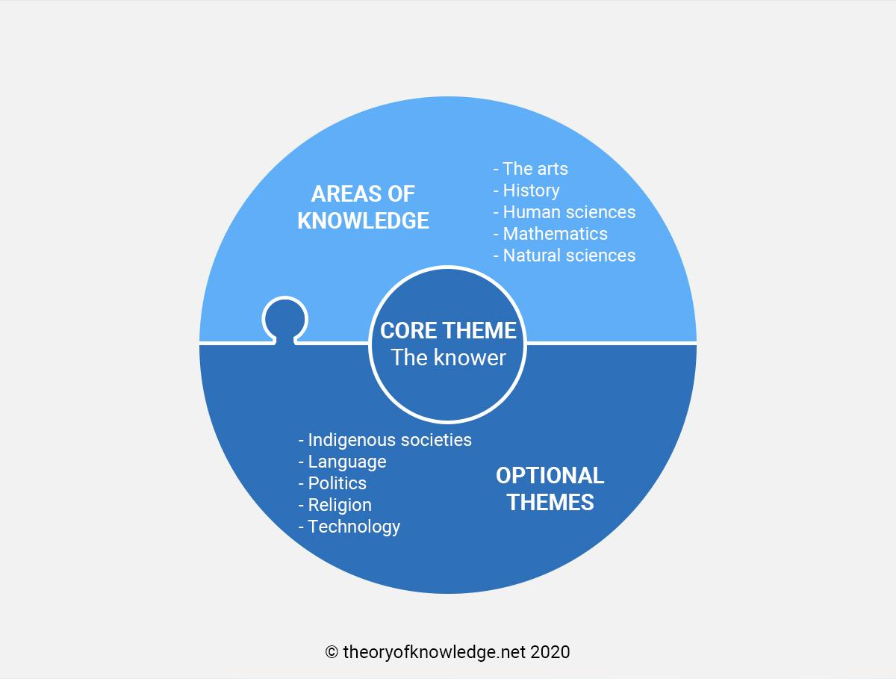
Exit
Which areas of knowledge and optional themes lend themselves more naturally to rationalism?
Which ones to empiricism?
Notes:
See the BQ1 assessment tracker for suggestions on providing feedback, and recording students’ progress

Slide 8
Linking this lesson to the course
During this lesson, we consider the highlighted aspects of the TOK course
The images used in the presentation slides can also give students ideas about selecting exhibition objects; see also our link below to specific IA prompts
CORE THEME | OPTIONAL THEMES | AREAS OF KNOWLEDGE | TOK ASSESSMENT
Knowledge & the knower | Indigenous societies | The arts | The TOK essay
 | Language | History
 | Politics | The human sciences | The TOK exhibition Could be linked to IAP-2 (types), IAP-28 (objectivity), IAP-33 (development)
 | Religion | Mathematics
 | Technology | The natural sciences

Slide 9
Explore the TOK themes and areas of knowledge in more depth via a range of thinkers, media sources, and other resources, in our EXPLORATION POINTS DOCUMENTS.
Access the documents via the links below. You’ll also find the EP icons on all of the TOK course pages of the site to help you unpack the quotes, KQs, and real-life situations that you find there.
CORE THEME
Knowledge & the knower
OPTIONAL THEMES
Indigenous societies
Language
Politics
Religion
Technology
AREAS OF KNOWLEDGE
The arts
History
Human sciences
Mathematics
Natural sciences
Notes:
Use this slide to access the ‘Exploration Points’ notes for BQ1, which will help students to develop a deeper knowledge of any TOK theme or area of knowledge. This will not only help them to master the TOK course in general, but also craft a great exhibition or essay.
Be ready to provide more guidance on how to use this resource - ie, which media sources to focus on, which questions to address, which TED talks to watch, and which key terms and ideas to understand.

